Slide 1


STRATEGIC RECOMMENDATIONS FOR ZOMATO'S RESTAURANT EXPANSION
2025
Presented by Anuraj Satardekar

Slide 2


What is Zomato?
Zomato is a global restaurant aggregator and food delivery platform that connects users with restaurants for discovery, ordering, and dining experiences.

Slide 3

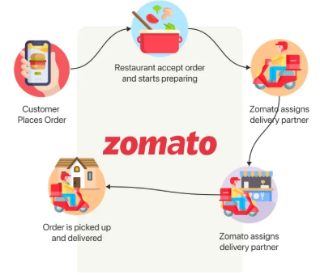
User Browses the App/Website
Searches for restaurants, cuisines, or dishes
Views ratings, reviews, and menu details
Order Placement
Customer places a food order or books a table
Payment is made online or opted as cash on delivery
Restaurant Confirmation
Restaurant receives the order or booking request
Prepares food and confirms order acceptance
Delivery Partner Assigned
Zomato algorithm assigns nearest delivery executive
Real-time order tracking enable
Order Delivery
Delivery partner picks up and delivers the food
User confirms receipt and rates the experience

Slide 4
PROBLEM STATEMENT
You are hired as a consultant data analyst by zomato where the team is looking for expansion and opening restaurants. Your task is to come up with strategies/suggestions about opening newer restaurants.

Slide 5
Solution Overview
We analyzed the restaurant dataset using pivot tables, visualizations, and an interactive dashboard to extract insights on:
Market saturation and restaurant count by country and city
Customer spending and satisfaction trends
Price range and cuisine performance
Service features like delivery and table booking

Slide 6
Data Overview
Restaurant ID: Unique identifier for each restaurant.
Restaurant Name: The name of the restaurant.
CountryCode: Country code of the location where the restaurant is situated.
City: The city where the restaurant is located.
Address: The specific address of the restaurant.
Locality: The locality or neighborhood where the restaurant is situated.
Locality Verbose: Detailed information about the locality.
Longitude: The geographical longitude coordinate of the restaurant.
Latitude: The geographical latitude coordinate of the restaurant.
Cuisines: The type of cuisine offered by the restaurant.
Currency: The currency used for transactions in the restaurant.
Has_Table_booking: Indicates whether the restaurant has a table booking option (Yes/No).
Has_Online_delivery: Indicates whether the restaurant offers online delivery (Yes/No).
Is_delivering_now: Indicates whether the restaurant is currently delivering (Yes/No).
Switch_to_order_menu: Indicates whether users can switch to the order menu (Yes/No).
Price_range: A numeric value indicating the price range category of the restaurant.
Votes: The number of votes or ratings/(feedback) received by the restaurant.
Average_Cost_for_two: The average cost for two people dining at the restaurant.
Rating: The overall rating of the restaurant is based on user reviews.
Datekey_opening: The date when the restaurant was opened.

Slide 7
Data Overview
Data Set Brief :
The dataset contains information on 9,551 restaurants across 15+ countries, with a total of 20 attributes capturing various operational and customer-related details.
It includes fields such as Restaurant ID, Name, Country, City, Address, Locality, Coordinates, Cuisines, Currency, Service Options (Table Booking and Online Delivery), Price Range, Average Cost for Two, Ratings, and Opening Date.
The price range is categorized from 1 (lowest) to 4 (highest), providing insight into affordability levels across regions.

Slide 8
Data Overview
Data Cleaning :
Missing values in the Cuisines column were handled by filling them with the most frequent cuisine (North Indian), while zero values in the Average Cost for Two were replaced with the mean value of ₹1199.21.
The Opening Date column was cleaned and reformatted using Text to Columns and the DATE() function, and the Country Code was translated into full country names using the VLOOKUP function.
This dataset is essential for analyzing market saturation, identifying growth opportunities, and understanding consumer preferences to guide Zomato’s restaurant expansion strategy.

Slide 9
METHODOLOGY
The analysis began with data cleaning, where missing values in categorical fields like Cuisines were filled using the most frequent value contry wise, and zero values in Average Cost for Two were replaced with the column mean.
Date formatting was corrected using Excel’s Text to Columns and DATE() function to ensure consistency in the Opening Date field.
The Country Code was mapped to full country names using the VLOOKUP function for easier interpretation and filtering.
We created multiple Pivot Tables to summarize key insights such as the number of restaurants by country and city, average ratings, pricing, and service availabilit

Slide 10
METHODOLOGY
Bar charts, stacked column charts, and other visual tools were used to highlight patterns in service offerings, restaurant distribution, and customer preferences.
We also applied Conditional Formatting to visually emphasize countries of strategic interest like Canada, Qatar, and Singapore.
Specific Excel functions such as IF, AND, MID, FIND, and ARRAYFORMULA (Google Sheets) were used to create custom columns, filters, and advanced counts.
Overall, the approach was focused on making the data accessible and insightful for strategic decision-making without overloading it with technical complexity.

Slide 11
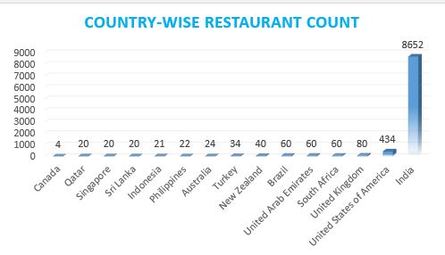
Restaurant Distribution Across Countries
The restaurant count is heavily concentrated in a few countries, with India alone accounting for over 8,600 outlets.
USA (434) and UK (80) follow distantly, reflecting regional saturation.
In contrast, countries like Canada (4), Qatar (20), and Singapore (20) remain largely untapped, presenting strong potential for strategic expansion.

Slide 12
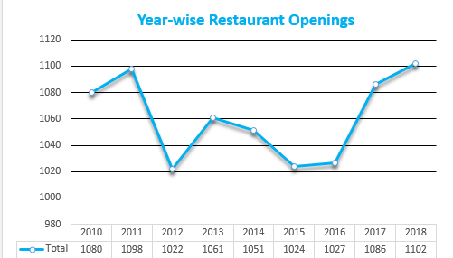
Year-wise Restaurant Growth
Restaurant openings steadily increased from 2010 to 2018.
2018 saw the highest number of launches (1,102), showing strong platform adoption.
Reflects rising consumer demand and digital growth momentum.
Favorable environment for expansion into new regions.

Slide 13
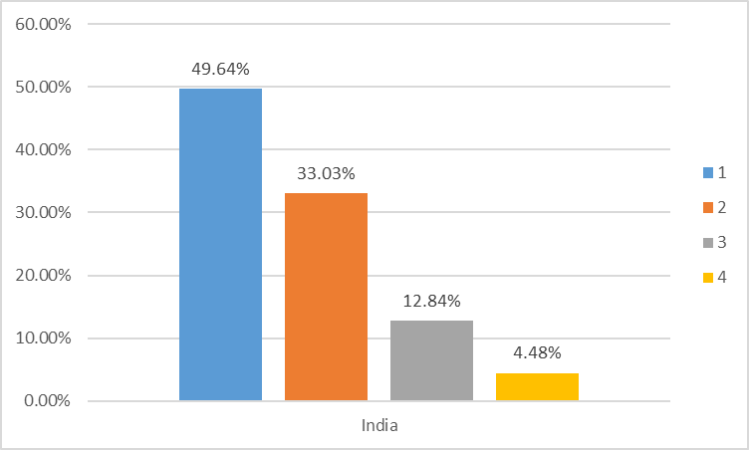
High-End Restaurants in India
Out of 8,652 restaurants in India, only 388 (≈4.5%) fall under Price Range 4.
Indicates a small upscale segment in a largely budget-oriented market.
Highlights opportunity for premium restaurant expansion in select urban areas.

Slide 14
Average Rating – Budget Restaurants with Online Delivery
Customers respond positively when a restaurant is both affordable and offers online delivery.
These budget-friendly, delivery-enabled restaurants average a rating of 3.27 — a strong score in the mid-range segment.
This reflects a key insight: value and convenience together drive customer satisfaction.
Recommendation: In competitive or cost-sensitive markets, combine affordable pricing with online delivery to build loyalty and boost ratings.

Slide 15
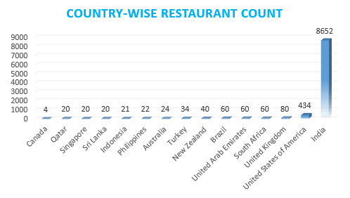
Identifying High-Potential Countries for Expansion
India leads with 8,652 restaurants, showing saturated competition.
Canada has just 4, and Qatar/Singapore only 20 each — indicating low competition.
These numbers reveal clear gaps in market presence across high-potential countries.
Target countries with low restaurant count like Canada, Qatar, and Singapore to tap into underserved markets.

Slide 16
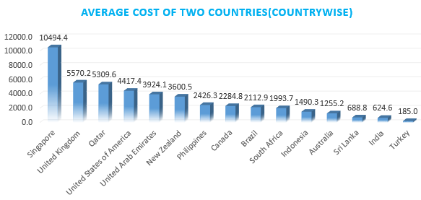
Identifying High-Potential Countries for Expansion
Singapore tops with ₹10,494 average spend — a strong premium market.
Qatar follows at ₹5,570 — supporting mid-to-high pricing models.
Canada averages ₹2,284 — suggests value-seeking behavior but faces minimal competition.
Leverage high spending potential in Singapore and Qatar with premium offerings; adopt a value-driven model for Canada.

Slide 17
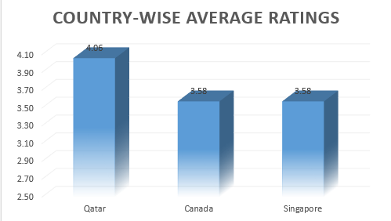
Assessing Restaurant Quality in Recommended Markets
Qatar shows the highest satisfaction with an average rating of 4.06, setting a strong quality benchmark.
Canada and Singapore have average ratings of 3.58, indicating moderate quality and scope for improvement.
In Canada and Singapore, focus on raising quality through better service, consistent experiences, and added value.
In Qatar, aim to match or exceed current standards to stay competitive in a high-expectation market.

Slide 18
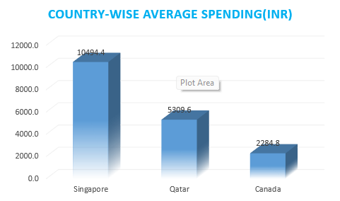
Average Customer Spending (INR) Across Recommended Countries
Canada: With an average spend of ₹2,211, the market suits casual or family dining. Focus on affordable, value-driven menus in Price Range 1–2.
Qatar: Average spending of ₹5,146 supports a mid-to-premium model. Emphasize premium service and elevated experiences in Price Range 3–4.
Singapore: At ₹9,656 average spend, the market favors luxury dining. Introduce high-end, gourmet offerings in Price Range 4.

Slide 19
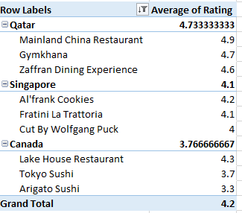
Competitive Landscape in Recommended Cities
In Qatar, top competitors include Mainland China, Gymkhana, and Zaffran Dining Experience.
In Singapore, notable names are Al’frank Cookies, Fratini La Trattoria, and Cut by Wolfgang Puck.
In Canada, existing players are Arigato Sushi, Tokyo Sushi, Lake House Restaurant, and Consort Restaurant — all single-location with moderate ratings.
Low-rated restaurants include Makansutra Gluttons Bay in Singapore and Consort Restaurant in Canada.
Focus on outperforming moderate competitors and strategically locating near low-rated restaurants to attract dissatisfied customers.

Slide 20
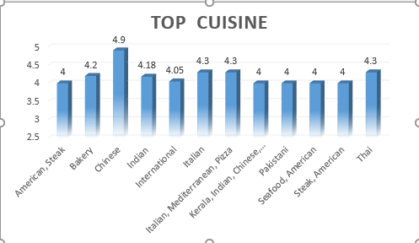
High-Performing Cuisines Across Markets
Canada: Customers favor Italian-Mediterranean and Sushi. Focus on Italian cuisine for broad appeal, and complement with Mediterranean and Sushi offerings.
Qatar: Top-rated cuisines include Italian, Chinese, and Thai. Build around Italian dishes and add Thai options to match local preferences.
Singapore: Italian, Bakery, and American-Steak perform best. Offer a strong Italian base and feature Bakery and Steakhouse concepts to boost satisfaction.

Slide 21
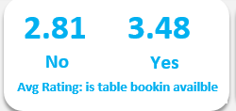
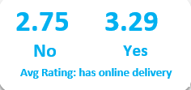
Impact of Online Delivery & Table Booking on Customer Ratings
India: Online delivery boosts ratings (3.28 vs. 2.57); enable delivery to sustain competitive satisfaction.
Qatar: Table booking leads to a 0.67 rating uplift (4.70 vs. 4.03); promote bookings to align with top performers.
Canada & Singapore: No delivery or booking services exist; introduce both to gain first-mover advantage and enhance experience

Slide 22
Balancing Pricing Strategy with Customer Feedback
Higher price ranges show a moderate positive correlation with ratings (0.4629), indicating that better quality and service often drive higher satisfaction.
Average spending has a weak correlation with ratings (0.1420), suggesting that spending more doesn't guarantee better feedback.
Recommendation: Focus on improving quality, service, and experience over raising prices. Once consistent, adjust pricing to match expectations in premium markets like Qatar and Singapore.

Slide 23
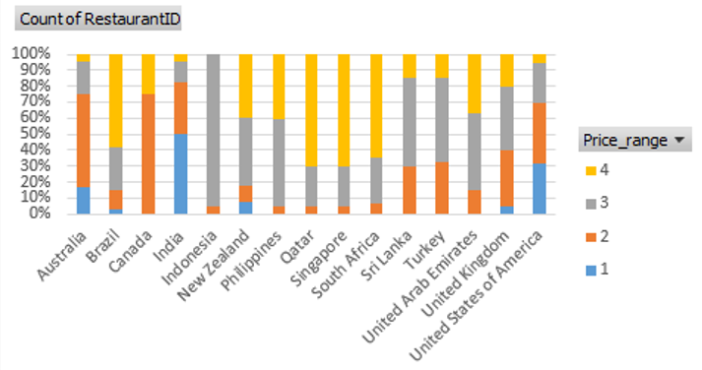
Distribution of Restaurants by Price Range Country wise
India: 83% of restaurants fall in Price Range 1–2, confirming a strong budget-driven market; focus on affordable formats.
Qatar & Singapore: ~70% of restaurants are in Price Range 4, showing premium-dining dominance; position high-end offerings accordingly.
Canada: Displays a budget vs. premium split but lacks mid-range options; introduce mid-tier concepts to bridge the pricing gap.

Slide 24
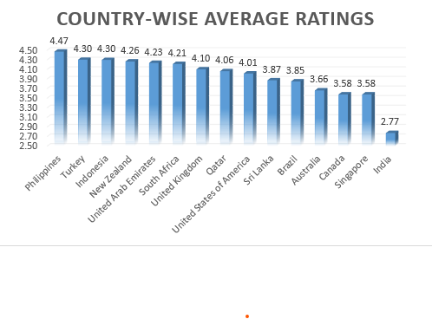
Global Restaurant Ratings by Country
Philippines (4.47), Turkey (4.30), and Indonesia (4.30) lead in customer satisfaction, indicating strong markets for quality-focused dining.
Qatar (4.06) and USA (4.01) also show above-average ratings, ideal for premium restaurant formats.
Canada and Singapore (both 3.58) reflect moderate satisfaction, offering room to improve quality and experience.
India, with the lowest rating (2.77), suggests a cost-driven market with potential for differentiation through quality and consistency.

Slide 25
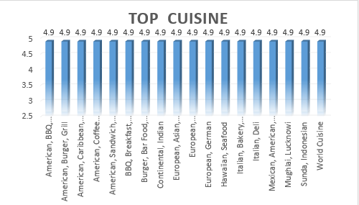
Globally Top-Rated Cuisines
A variety of cuisines received high global ratings (4.9), indicating broad satisfaction across Western, Asian, and fusion styles
High ratings reflect that quality and consistency matter more than cuisine type alone.
Recommendation: Lead with globally popular cuisines (e.g., BBQ, Italian, Indian, Mexican), and blend with local flavors.
Focus on execution, consistency, and presentation to ensure strong customer feedback.

Slide 26
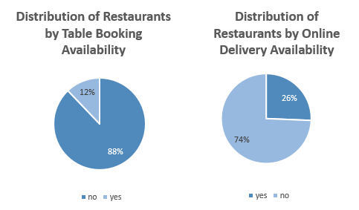
Service Gaps in the Global Restaurant Market
Just 26% of restaurants support online delivery, despite rising deman.
Three-fourths of restaurants miss out on a key convenience factor.
Enable online delivery in low-penetration markets (e.g., Canada, Singapore) to gain first-mover advantage and capture unmet demand.

Slide 27
Service Gaps in the Global Restaurant Market
Only 12% of restaurants globally offer table booking.
A massive 88% lack this feature — highlighting a major service gap.
Introduce table booking in underserved regions to enhance experience and fill a clear market gap.

Slide 28
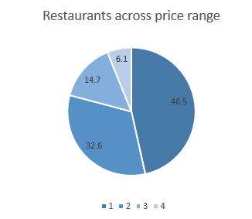
Global Distribution of Restaurants by Price Range
~80% of restaurants fall in Price Ranges 1–2, reflecting a global budget-to-mid market focus.
Only 6.1% operate in Price Range 4, showing low competition in the premium segment.
Price Range 3 accounts for 14.7%, signaling opportunity in mid-tier offerings.

Slide 29
STRATEGIC RECOMMENDATIONS FOR EXPANSION
Open restaurants in low-competition, high-potential countries like Canada, Qatar, and Singapore.
Target underserved cities with low restaurant density for easier entry and faster traction.
Leverage density and price-range analysis to identify scalable growth areas.
Align pricing with regional spending behavior to match customer expectations.
Offer top-rated local cuisines to boost acceptance and satisfaction.
Introduce online delivery and table booking in underpenetrated markets to enhance service value.
Monitor customer sentiment and competitor positioning to continuously improve quality and retain loyalty.

Slide 30
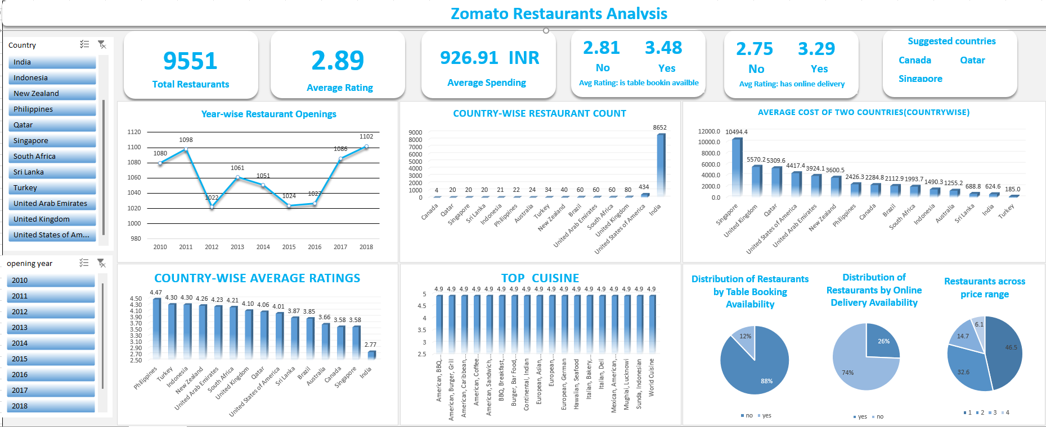
Dashboard

Slide 31
CONCLUSION
The analysis revealed clear expansion opportunities in low-saturation countries like Canada, Qatar, and Singapore, supported by data on restaurant count, service availability, and average spending.
City-level insights highlight specific locations with minimal competition, making them ideal for targeted entry with reduced risk and high visibility.
Tailoring offerings to local cuisine preferences and aligning pricing with market-specific spending behavior ensures better customer acceptance and profitability.
Introducing online delivery and table booking in new markets offers a competitive edge and directly correlates with improved customer ratings.

Slide 32
THANK YOU

